Slide 1
Early Detection of Fake News by Utilizing the Credibility of News, Publishers, and Users Based on Weakly Supervised Learning
Chunyuan Yuan, Qianwen Ma, Wei Zhou, Jizhong Han and Songlin Hu
Institute of Information Engineering, Chinese Academy of Sciences
School of Cyber Security, University of Chinese Academy of Sciences
Proceedings of the 28th International Conference on Computational Linguistics（2020）
Zhuomin Chen
2021.07.13

Slide 2
Introduction
Early research on fake news detection mainly focused on textual content, user profiling data, and news diffusion patterns.
The main limitation of these methods is that they ignore the importance of publishers and users credibility for the early detection of fake news.

Slide 3
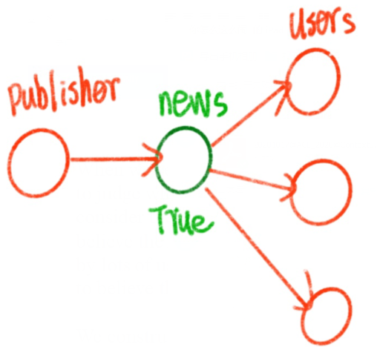
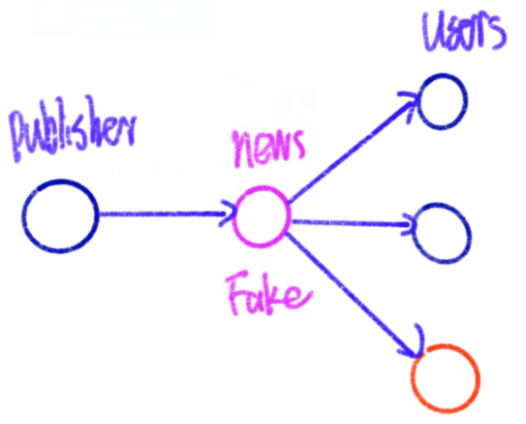
Introduction
We construct a heterogeneous graph to build the connections of publishers, news, and users.

Slide 4
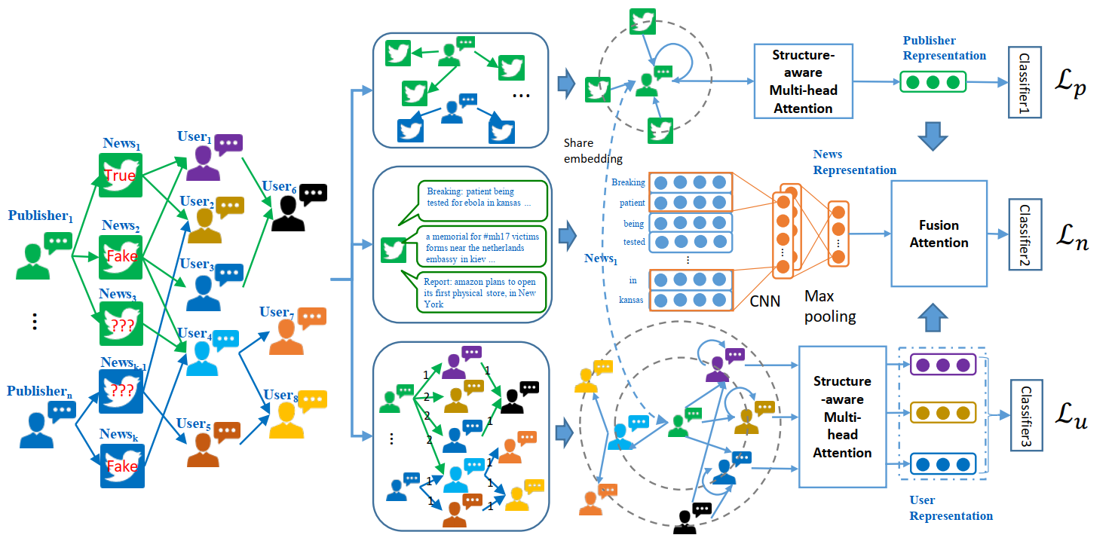
The Proposed Framework

Slide 5
Publisher Credibility Prediction

Slide 6
Publisher Credibility Prediction

Slide 7
User Credibility Prediction

Slide 8
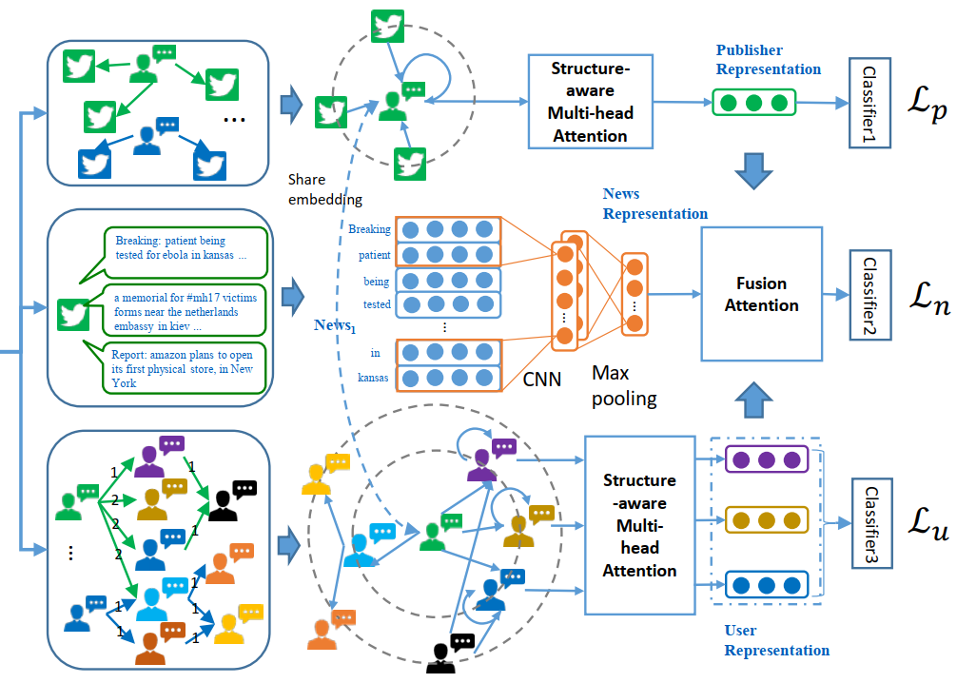
Fake News Classification

Slide 9
Datasets

Slide 10
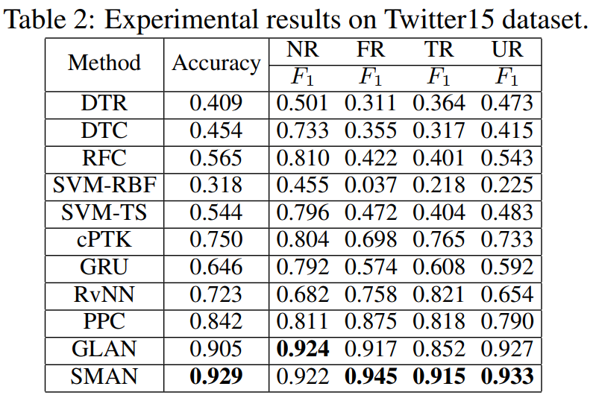
Experiment

Slide 11
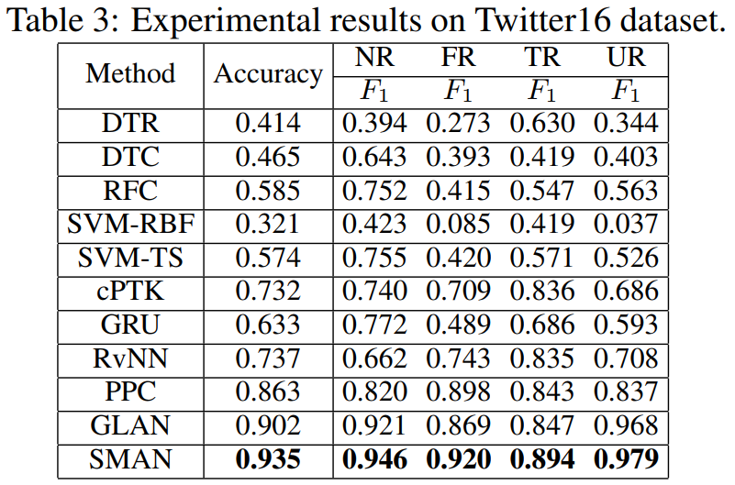
Experiment

Slide 12
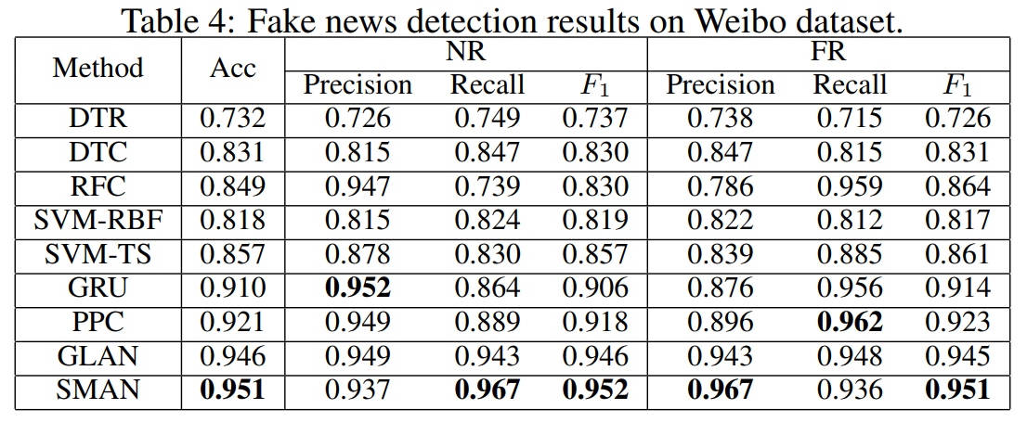
Experiment

Slide 13
Ablation Study

Slide 14
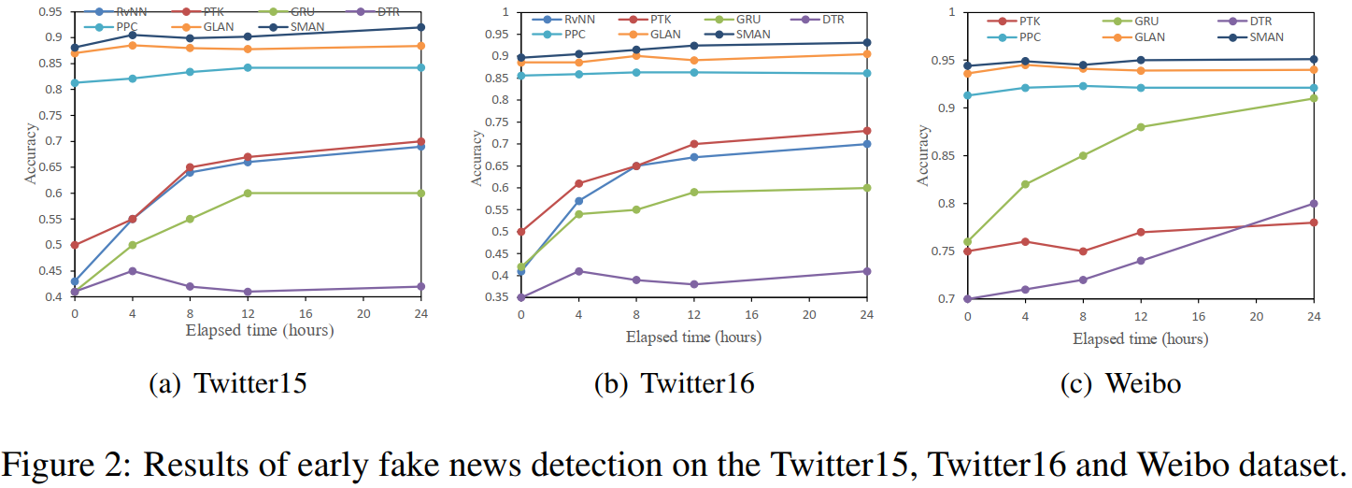
Early Detection

